Slide 1

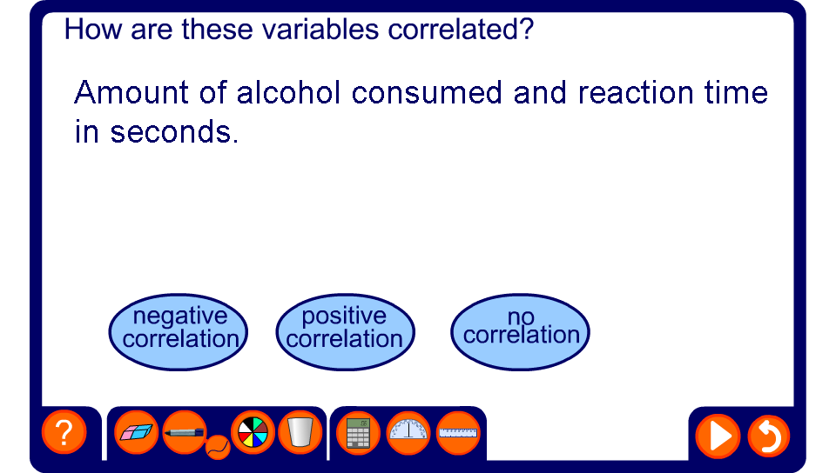


Relationships between two variables
Notes:
This activity should provoke discussion. You and the class may not always agree with the answers given by the activity. You might discuss how you would test each correlation.

